Slide 1

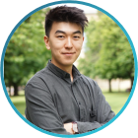
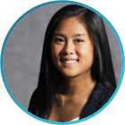





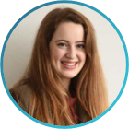
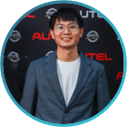
Pecha Kucha 3 – From prototyping to the final product
Group 4
Amadou, Anouar, Dennis, Gregor, Linyan, Magdalena, Melina, Nils, Thu, Xiaogang

Slide 2

Outline for today
Setup of our web application
Preprocessing setup
First modeling results
Challenges we need to tackle
Next steps

Slide 3
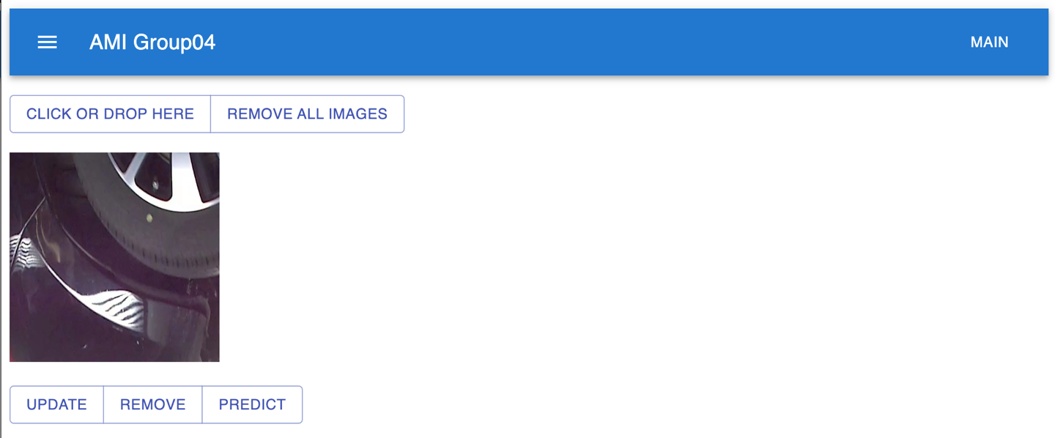
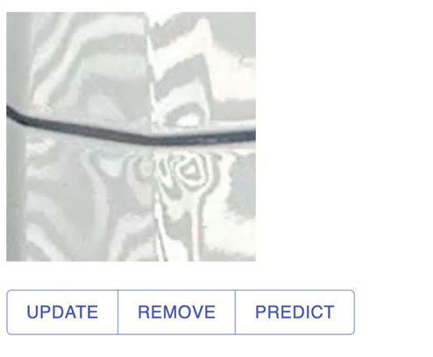
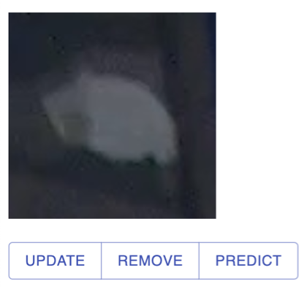



First mock-up of our web application
Challenges
Integrating our model smoothly to our web app
Creating meaningful
visualisations
Ensuring a fast and responsive web app
Notes:
Functionality, what is still missing, features we might want to add

Slide 4
Pre-processing: Achievements & challenges
Achievements
Labelled the data
Implemented resizing function
Created data augmentation module
Challenges
Evaluating the influence of preprocessing and data augmentation
Ensuring correct labels (some damages are hard to classify)
Notes:
Here everything we know about augmentation is to be used.
The census altering augmentation is it's separate category because:
color augmentations that change color averageness of an image will be used to make the count of each color the same. I.e. ratio of red,green,and blue images is 1:1:1
After that it's all fair game to use any augmentations to increase the size of the dataset.

Slide 5
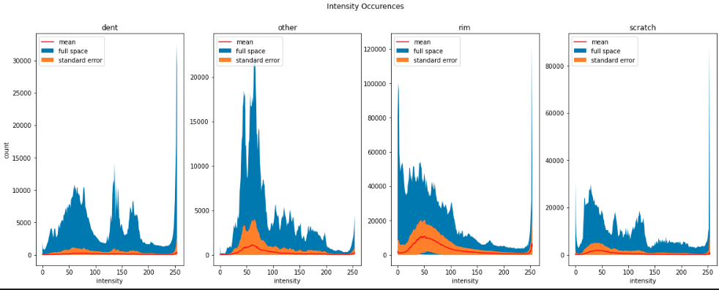
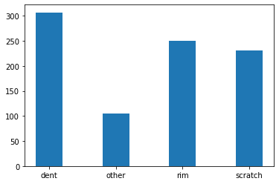
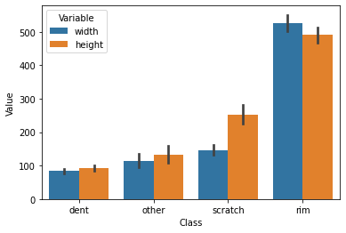
Data exploration: Understanding our data in depth
Pixel intensity distributions
Dataset skewedness:
Three times more dents than others
Image size:​
Large images
→ rim
Elongated images
→ scratch

Slide 6
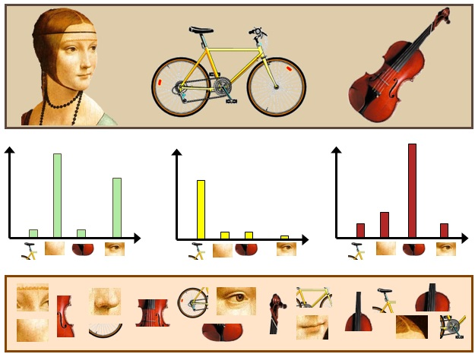
Baseline model using hand engineered features
“Bag of words”
Previous feature extraction
Color distribution
Extract features
Image area
Support Vector Machine
Image ratio
≈ 70% Accuracy
Represent occurrences
Training

Slide 7
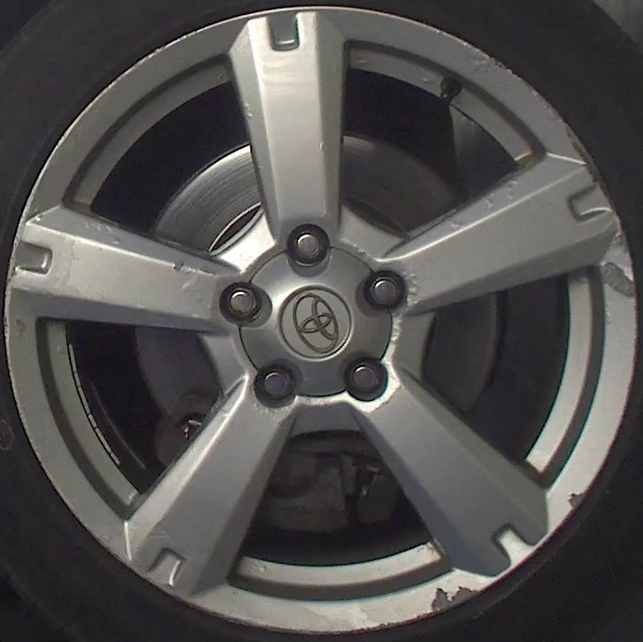
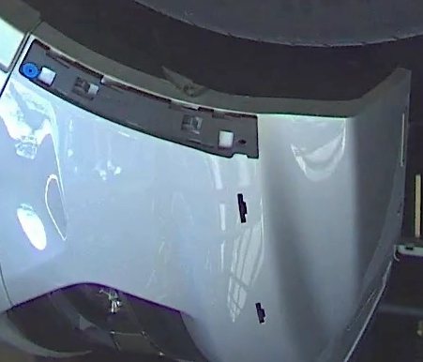
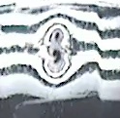
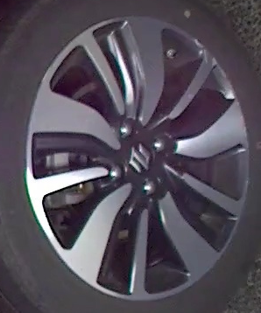

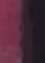
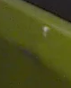
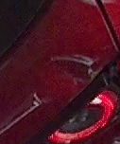



Active Learning for labeling the data
Scenario: Pool-based sampling
2 selected samples per iteration
Pool set
Selection:
Least confidence
Selected Samples
Active Learner
Seed
Seed: ~90
Validation: ~ 45
Feed new samples to train set
no oracle, true labels known

Slide 8






Active Learning for labeling the data
Evaluate informativeness
calculate
pool
uncertainty of sample pairs
Retrain on “new” train data and evaluate on test data
1 Round of Active Learning
Determine and label 2 most uncertain pool samples
2 most uncertain samples
transfer
train
pool

Slide 9
Active Learning: Challenges & next steps
Initial results
Unimpressive performance with MobilenetV2 (below 50%)
Possible explanations
Obtaining feature representation in minority informative samples difficult with CNNs
Assumption: Fixed feature representation for sample selection
Small labelled dataset
Possible Improvements
Use transfer learning in conjunction with active learning

Slide 10
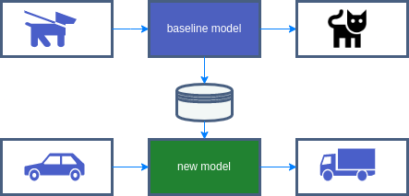
Introducing transfer learning
What is transfer learning?
Project context
Low hanging fruit
Get a first model around which the project can grow
Benchmark for future models
Baseline model
General train data
Learned knowledge
new model
Motivation:
Baseline model is SOTA
Effective with a small number of training images
Computationally efficient
Easily implemented
Specific train data
Specific test data

Slide 11
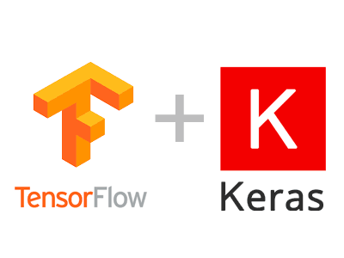
Implementing transfer learning
ImageNet challenge
Our tools
Keras API for the past ILSVRC winners
Using latest high-scoring API: EfficientNetV2
What EfficientNet is about
Deep CNN architecture
Build through neural architecture search
Compound scaling for models of different sizes and performances
Scaling image resolution, width and depth to increase accuracy by constant factors

Slide 12
Implementing transfer learning
Our tools
Keras API for the past ILSVRC winners
Using latest high-scoring API: EfficientNetV2
What EfficientNet is about
Deep CNN architecture
Build through neural architecture search
Compound scaling for models of different sizes and performances
First results
Zero unfrozen layers yields 60% validation accuracy
75% by tuning top network
80% by unfreezing 100 layers

Slide 13

Transfer learning: Network structure
Evaluation
Train on given Dataset
First loop
Second loop
Design network
Top network
Train network
Added Layers
Baseline model
Unfreeze layers
Pretrained on different Dataset

Slide 14
Challenge & targets for transfer learning
Selecting the correct model
Selecting from a variety of models & Tuning hyperparameters
Understanding the influence of compound scaling
Open questions for the baseline model
Understanding the benefit of the ImageNet domain
Interpreting the network accuracy correctly
Finetuning the model
Running Hyperparameter search with better hardware

Slide 15
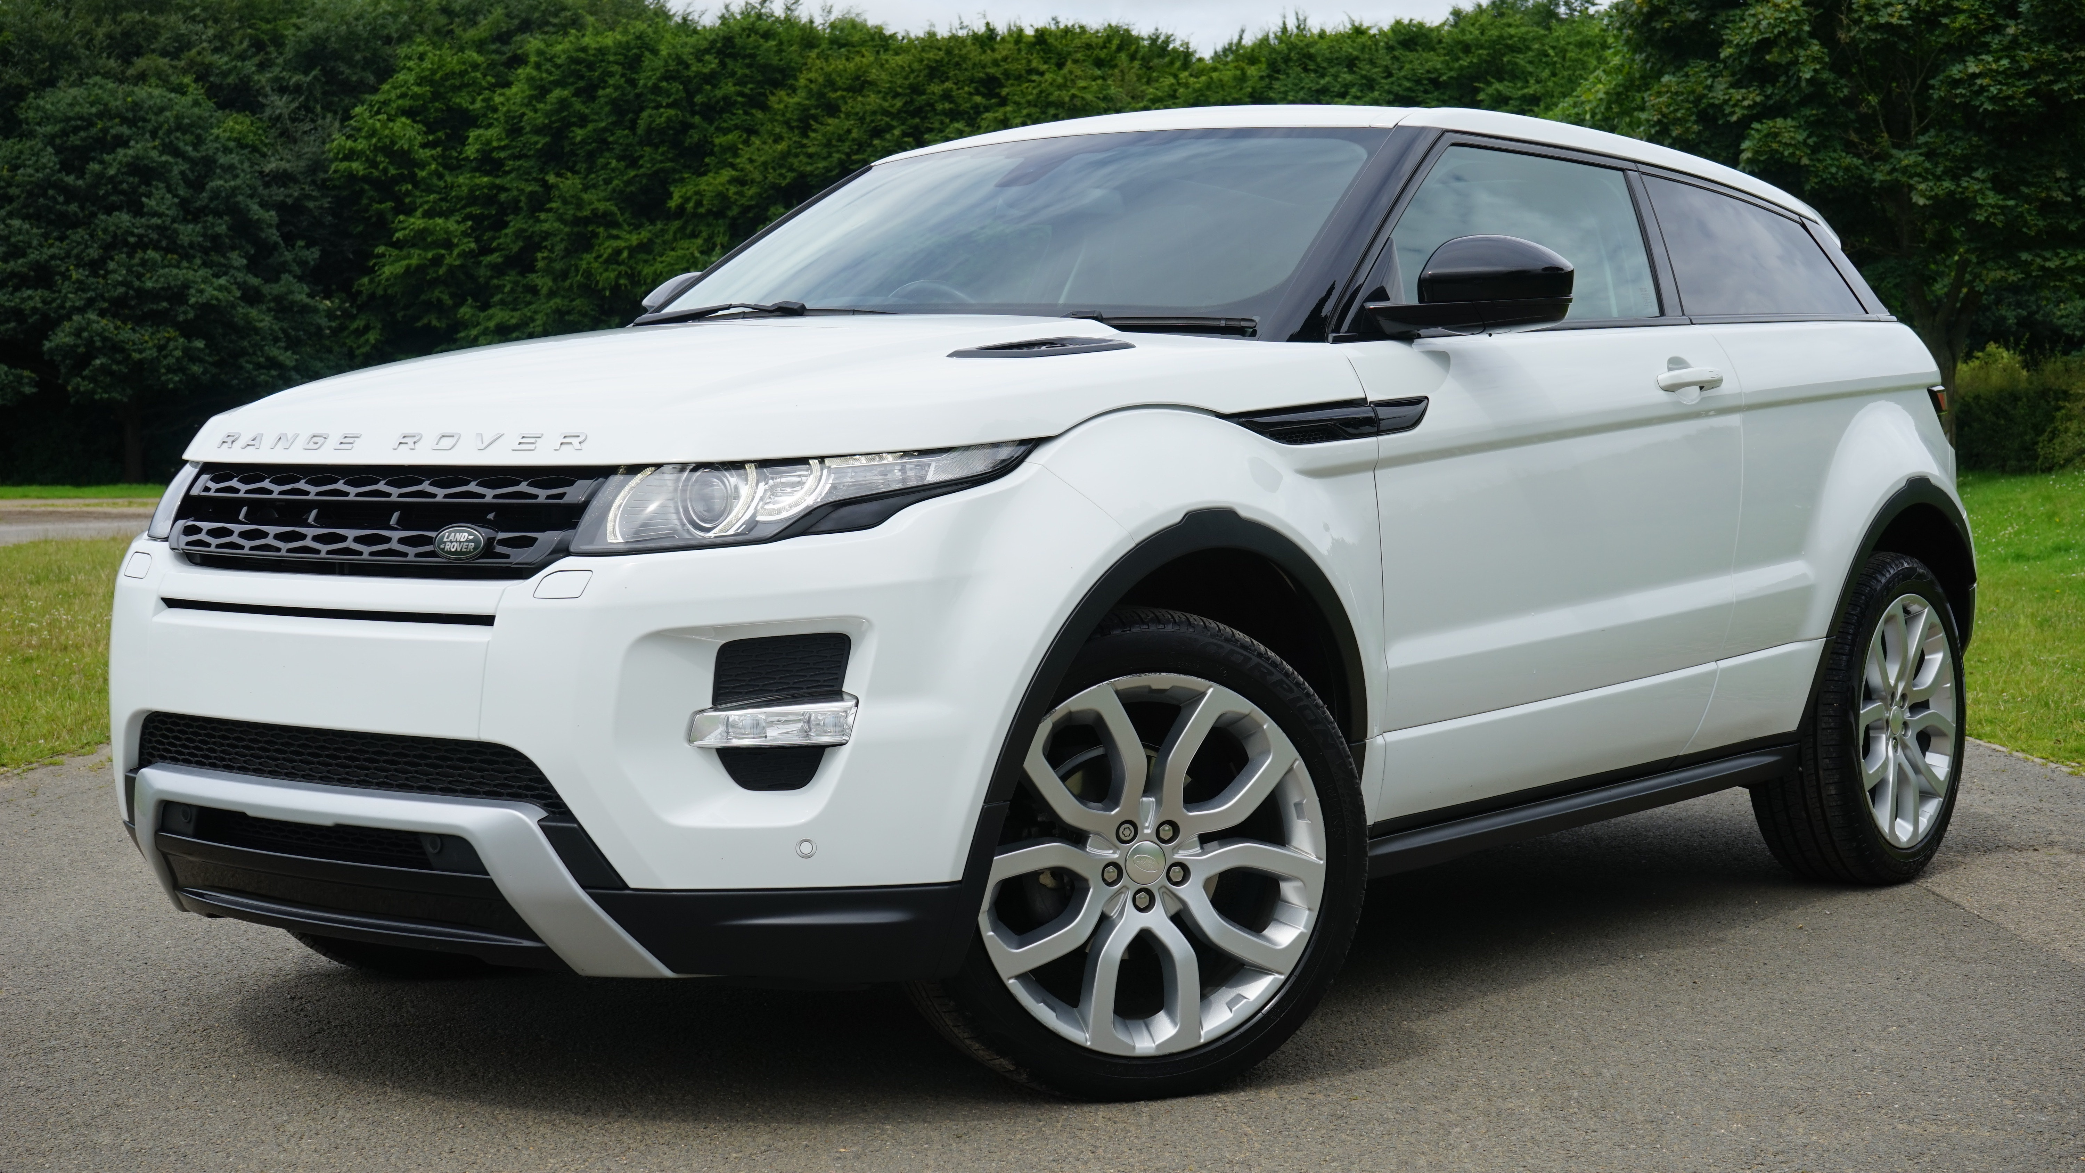
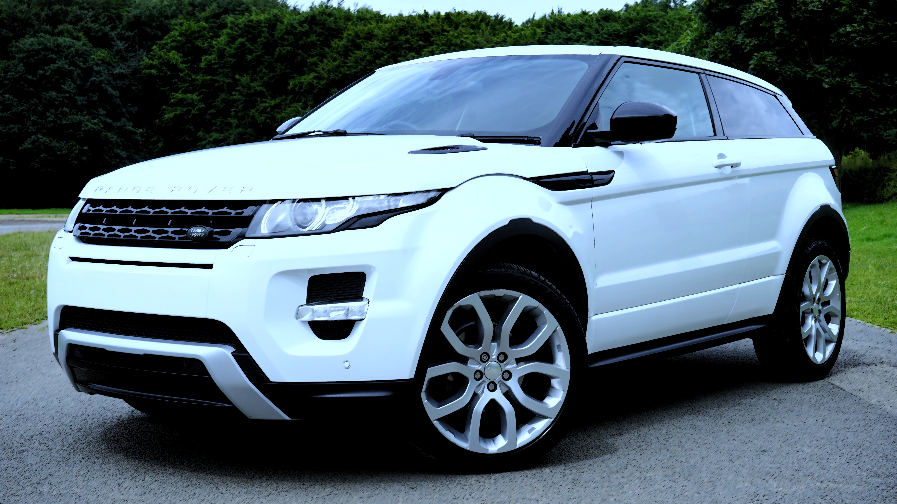
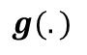
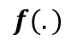
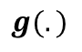
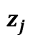
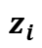
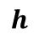
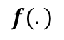
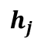
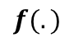
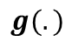
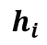
Using contrastive loss to train without labels
$$f(.)$$
$$g(.)$$
$$h_{i}$$
$$z_{i}$$
Contrastive Loss
(i.e. maximize agreement using cosine similarity)
$$f(.)$$
$$g(.)$$
$$h_{j}$$
$$z_{j}$$
$$f(.)$$
- Encoder (ResNet 50)
$$g(.)$$
- Predictor (MLP)
$$h$$
- Representation
Notes:
The next method we worked on is based on the ability of the network to detect similar images and distinguish between different ones. To train the network for this task we use contrastive loss. We augment one image such that the two images are similar but not the same. We encode these images and use a predictor to classify the embeddings. The goal is to maximize agreement using cosine similarity.

Slide 16


We implemented self-supervised learning with Similar Siamese Networks
1. Backbone encoder training
2. Classifier fitting and inference
feedback loop
KNN
similarity
K-Nearest neighbor classifier
embeddings
predictor
encoder
dimensionality reduced
encoder
encoder
augmented images
First accuracy results: 66%
input image
Notes:
Our implementation is based on the Similar Siamese Network structure which use a specific feedback loop called greadient stopping to prevent the network from collapsing. A collapsed network can‘t distinguish between different pictures and classifies every image pair as similar. We then use a K nearest neighbour classifier on the embeddings and could already achieve an accuracy of 66% in our first experiments.

Slide 17
Challenges and planned refinements for the Simple Siamese Network approach
Make use of more data augmentation techniques
1
Currently only small set of images for training the Siamese Network
Test performance with larger dataset of “undamaged cars”
Test different models for classification of embeddings
2
Until now only KNN tested as classifier
Evaluate influence of classifier and encoder on accuracy
Notes:
As we currently train the encoder only on the given bounding boxes, the dataset is very small. Going forward we want to explore more data augmentation techniques and the use of pictures without damages to improve the encoder.
Additionally we want to evaluate the influence of different classifiers on the embeddings and thus improve the accuracy of this approach.

Slide 18
Challenges we are facing in our team
Correct Labelling
Making sure our manually added labels are correct
Computational Resources
Being able to test our pipeline in a time-efficient way
Communication
Making sure, everyone stays on board and splitting all tasks efficiently

Slide 19
Challenges we are facing as individuals
Grasping the big picture
Understanding the whole machine learning pipeline
Priorities
Distinguishing which approaches and methods are best for our specific dataset
Co-Coding sessions
Organize regular timeslots where everyone is available

Slide 20
Modeling
Explore and refine our selected modeling methods
Next steps
Webapp
Integrate our code in our webapp
Optimize Visualization and User Experience
Final Report and Video
Start planning outline of final report and content of video
◻︎ Web Application | ◻︎ Pre-processing | ︎︎ Modeling | ︎︎ Challenges | ◼︎ Next steps

